Slide 1

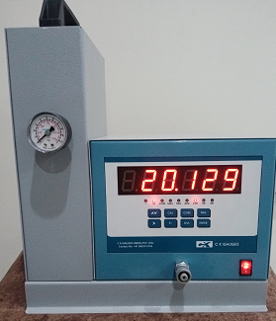
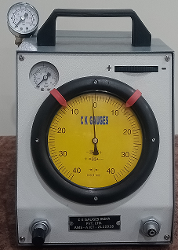
C K Gauges India Pvt. Ltd.
A PASSION FOR PERFECTION
AN ISO 9001 : 2015

Slide 2





C K Gauges India Pvt. Ltd.

Slide 3
C K Gauges India Pvt. Ltd.
DEALS IN:
1. SALES:
AIR GAUGE UNIT & AIR ELECTRONIC UNIT.
Air Ring Gauge, Air Plug Gauge, Air Caliper (Steel, Hard chrome Plated and Carbide
Snap Gauge, Plug Gauge & Width Gauge (Steel & Carbide)
Spare Parts of Air Gauge Unit & Electronic Unit.
Thread plug gauge/ Thread Ring Gauge
Receiving gauge
Multi gauging
Automation
Online SPC Software.
2. SERVICE:
Annual Maintenance Contract
Repairing
3. CALIBRATION:

Slide 4
C K Gauges India Pvt. Ltd.
COMPANY ADDRESS:
DELHI OFFICE: PLOT NO. 518/8, KARKARI ROAD, 60 ft., VISWAS NAGAR,
SHAHDARA, DELHI- 110032.
WORKS: S.NO.311, LANE NO.7, NEAR KOHINOOR WASHING CENTRE, SASANE NAGAR, HADAPSER, PUNE-411028.(M.H)
WORKS: PLOT NO.88, RAJENDER NAGAR INDUSTRIAL AREA, MOHAN NGR, SAHIBABAD, GHAZIABAD (U.P).
CONTACT NO. : 09953113163 , 09718889509, 09625055928.
EMAIL ID : ckgauges@gmail.com ckenterprises001@gmail.com,
WEBSITE: www.ckgauges.com
PAN NO. : AAGCC0108G
GSTIN NO. : 07AAGCC0108G2Z6
SERVICE TAX NO.: AAGCC0108GSD001

Slide 5
C K Gauges India Pvt. Ltd.
INTRODUCTION:
You can get Manufactured AIR GAUGES, ELECTRONIC GAUGES, AIR RINGS & AIR PLUGS etc, as we are providing this to highly reputed Companies.
The Team is well Educated, Technically advanced and experienced with Tool Room experience above 15 years.
DELIVERY:
We also assure you for the Delivery of our Products, we deliver the Gauges within 20-25 days after receiving the Purchase Order.
LIFE OF GAUGES:
STEEL GAUGE: 1,50,000 Component
HARDCHROME: 3,00,000 Component
CARBIDE: 4,00,000 Component

Slide 6
C K Gauges India Pvt. Ltd.
OUR PRODUCTS:
DIAL AIR GAUGE UNIT. MOD. 1A and A JET
AIR ELECTRONIC AUTO OFFSET UNIT
AIR ECTRONIC COLUMN TYPE UNIT
AIR ELECTRONIC TRI COLOR SINGLE CHANNEL UNIT
AIR ELECTRONIC TWO CHANNEL TRI COLOR DIGITAL UNIT
AIR ELECTRONIC THREE CHANNEL TRI COLOUR DIGITAL UNIT
AIR ELECTRONIC FOUR CHANNNEL TRI COLOUR DIGITAL UNIT
AIR ELECTRONIC COLUMN TYPE TRI COLOUR UNIT
AIR ELECTRONIC SINGLE DISPLAY TWO OUTPUT AUTO SENSING UNIT
AIR ELECTRONIC SINGLE DISPLAY THREE OUTPUT AUTO SENSING UNIT
SPC SOFTWARE
AUTO OFFSET UNIT
THREAD PLUG GAUGE/ THREAD RING GAUGE
RECEIVING GAUGE, JIG FIXTURE, MACHINERY PARTS
AIR PLUG GAUGE ( CHROME PLATED)
AIR RING GAUGE
AIR CALIPER
MULTIGAUGE
SPARE PARTS

Slide 7
C K Gauges India Pvt. Ltd.
DIAL AIR GAUGE UNIT - A JET

Slide 8
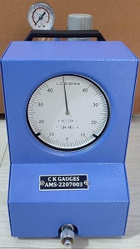
C K Gauges India Pvt. Ltd.
DIAL AIR GAUGE UNIT- MOD. 1A

Slide 9
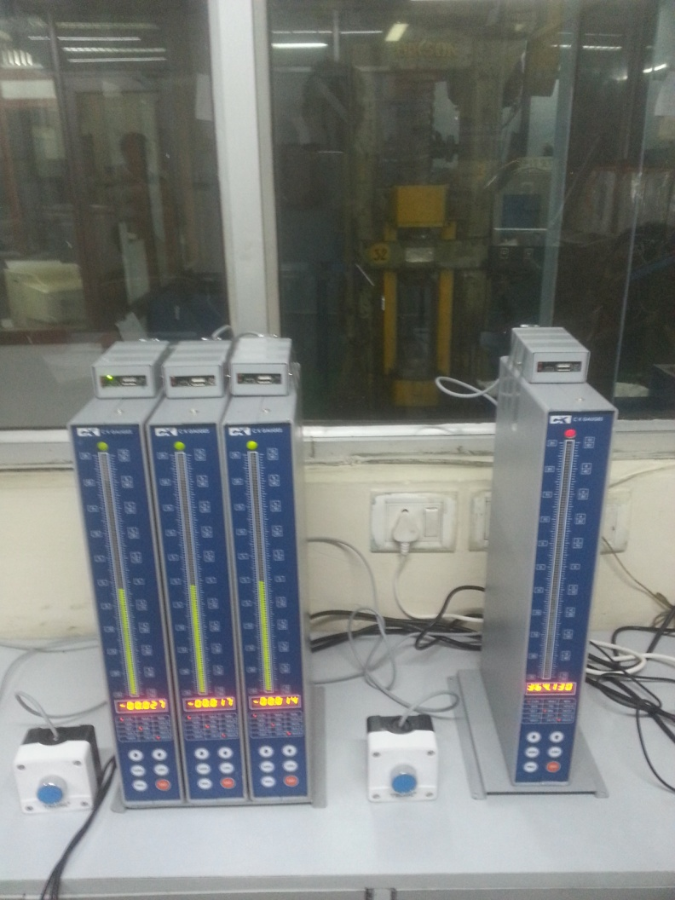
C K Gauges India Pvt. Ltd.
AIR ELECTRONIC COLUMN TYPE UNIT

Slide 10
C K Gauges India Pvt. Ltd.
AIR ELECTRONIC BIG DISPLAY UNIT

Slide 11
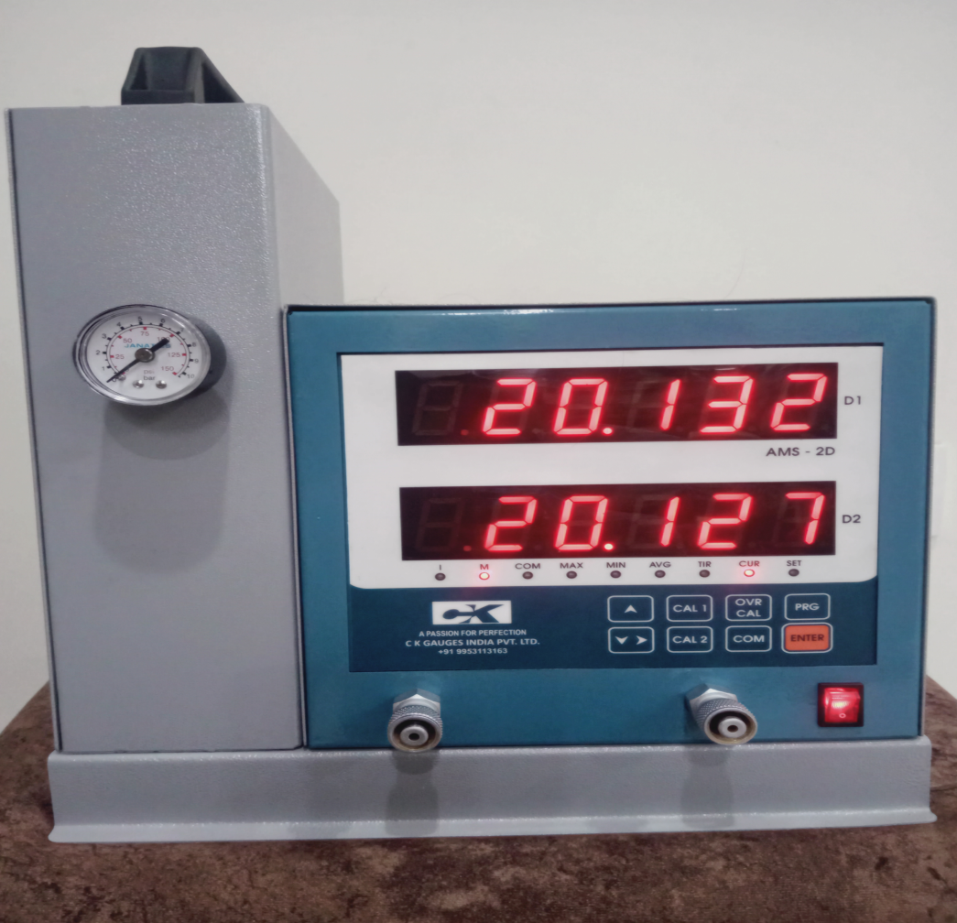
C K Gauges India Pvt. Ltd.
AIR ELETRONIC TWO CHANNEL TRI COLOUR DIGITAL UNIT

Slide 12
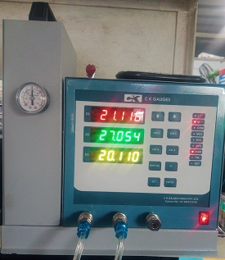
C K Gauges India Pvt. Ltd.
AIR ELECTRONIC THREE CHANNEL TRI COLOUR UNIT

Slide 13
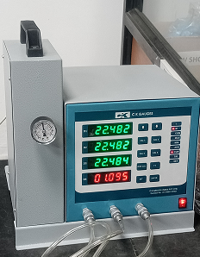
C K Gauges India Pvt. Ltd.
FOUR CHANNEL FOUR DISPLAY UNIT

Slide 14
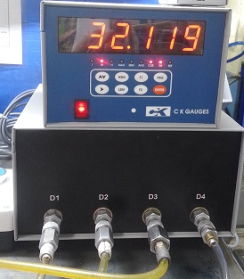
C K Gauges India Pvt. Ltd.
AIR ELECTRONIC FOUR CHANNEL TRI COLOUR UNIT

Slide 15
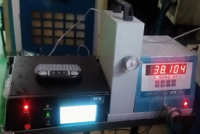
C K Gauges India Pvt. Ltd.
SINGLE DISPLAY AUTO OFFSET UNIT

Slide 16
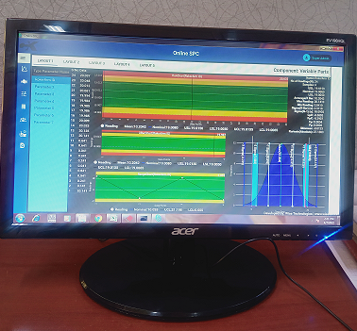
C K Gauges India Pvt. Ltd.
ONLINE SPC SOFTWARE

Slide 17
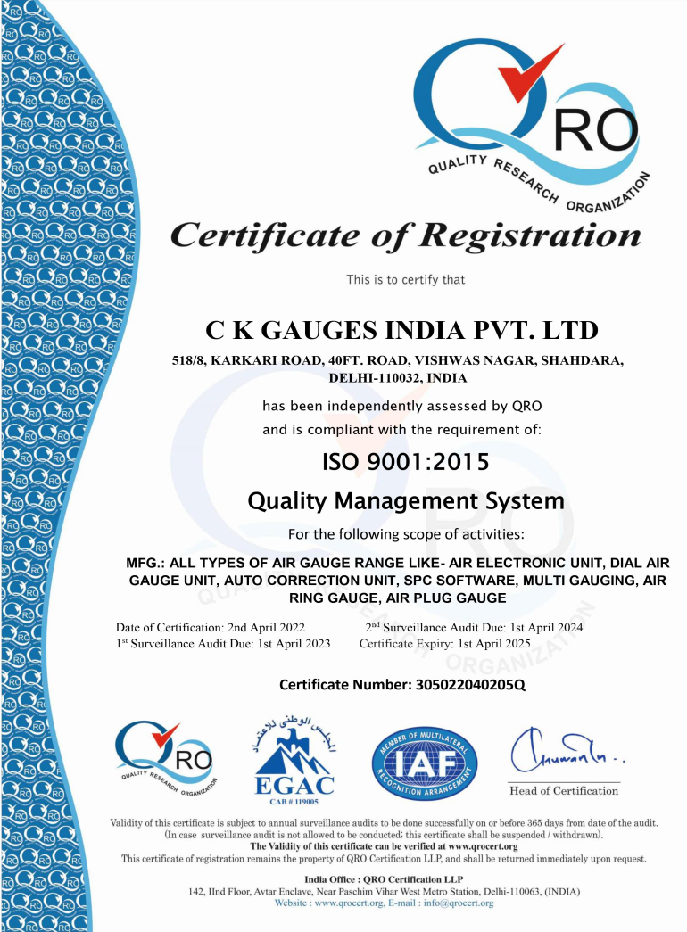
C K Gauges India Pvt. Ltd.
ISO 9001 2015

Slide 18
C K Gauges India Pvt. Ltd.
THANK YOU
WE ASSURE YOU FOR OUR BEST SERVICES AT ALL TIME
Email: ckgauges@gmail.com
Website: www.ckgauges.com
Mobile: +91 9 953113163
+91 9718889509
+91 9625055928

